Slide 1


Slide 2

Numerical Methods
Numerical Solution of Ordinary Differential Equations
National University of Science and Technology, Islamabad

Slide 3
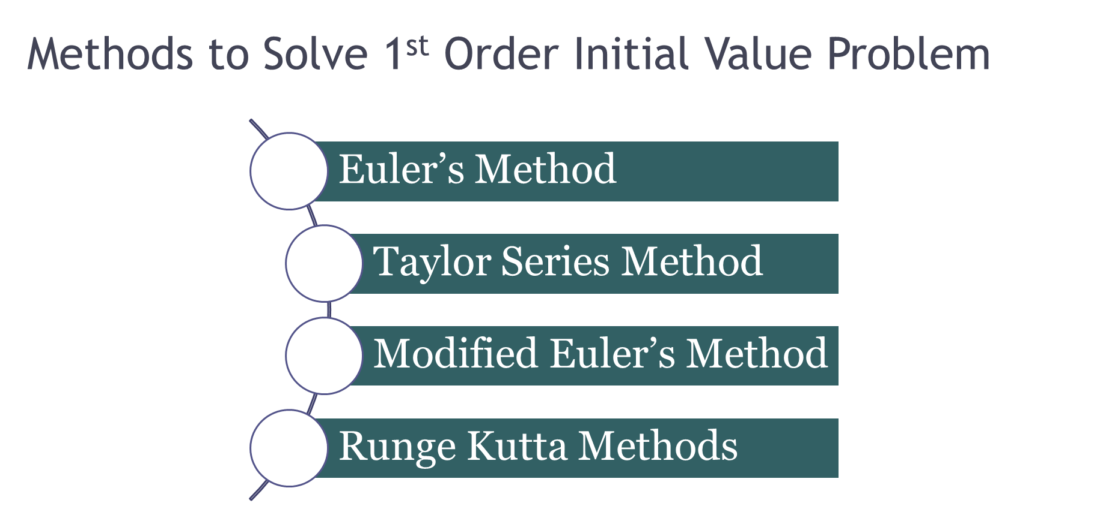
Numerical Methods
National University of Science and Technology, Islamabad

Slide 4
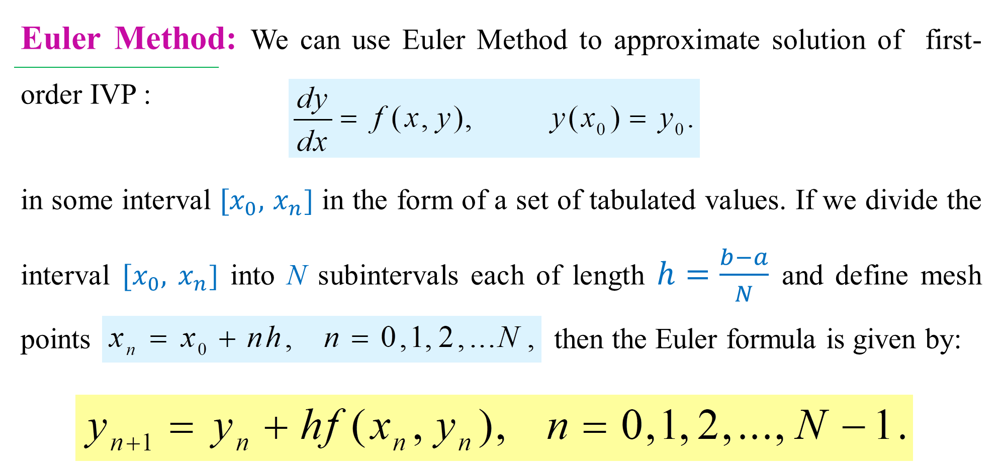
Numerical Methods
National University of Science and Technology, Islamabad

Slide 5
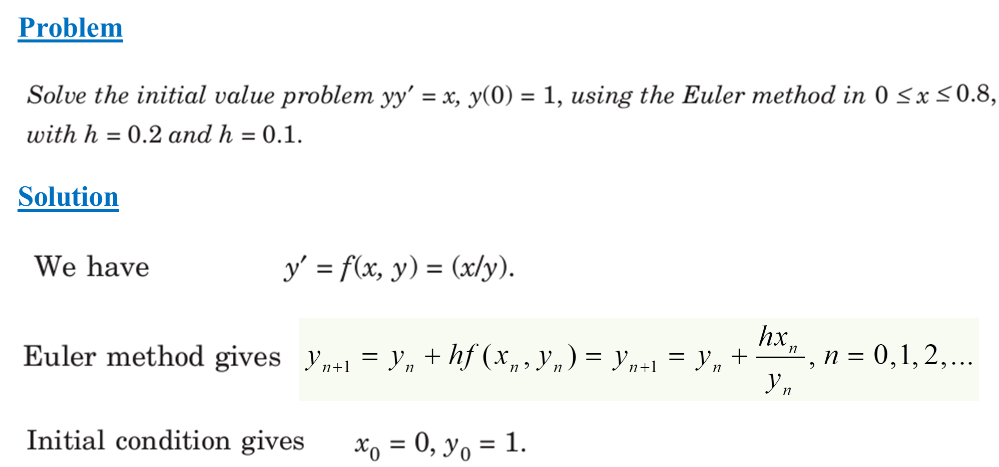
Numerical Methods
National University of Science and Technology, Islamabad

Slide 6
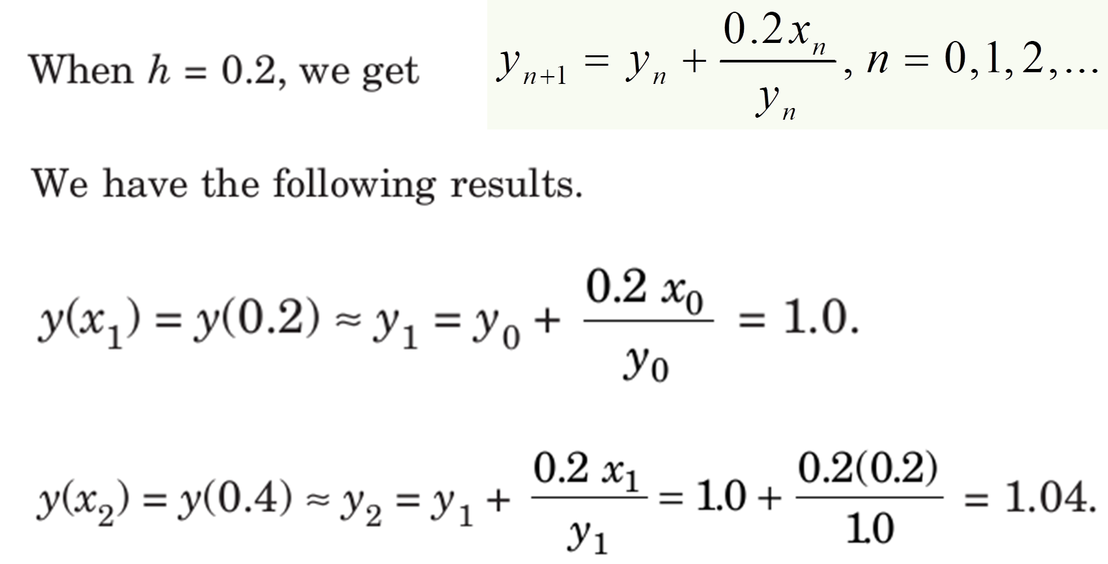
Numerical Methods
National University of Science and Technology, Islamabad

Slide 7
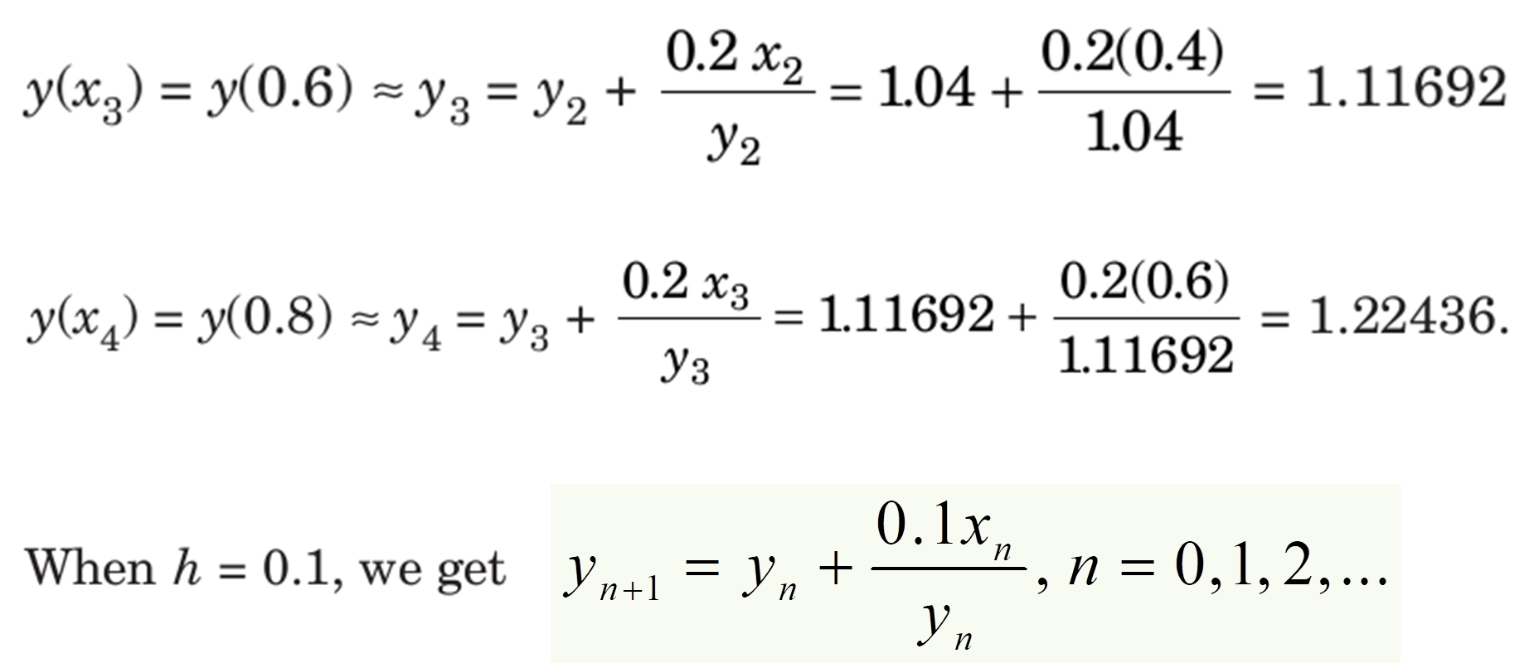
Numerical Methods
National University of Science and Technology, Islamabad

Slide 8
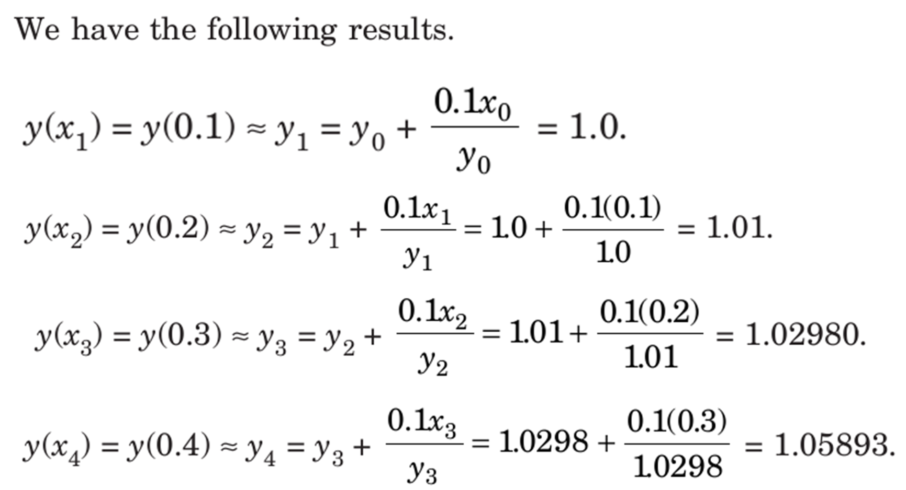
Numerical Methods
National University of Science and Technology, Islamabad

Slide 9
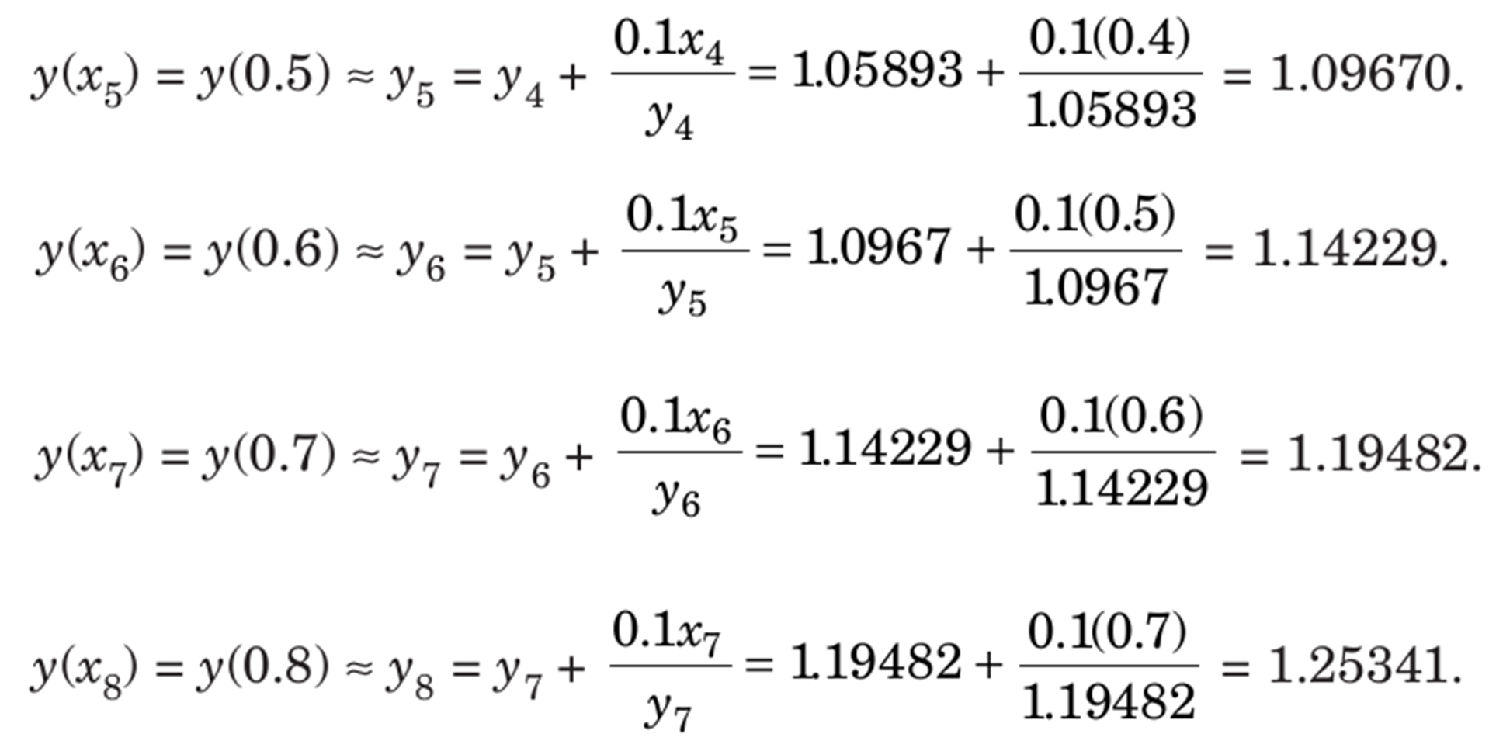
Numerical Methods
National University of Science and Technology, Islamabad

Slide 10
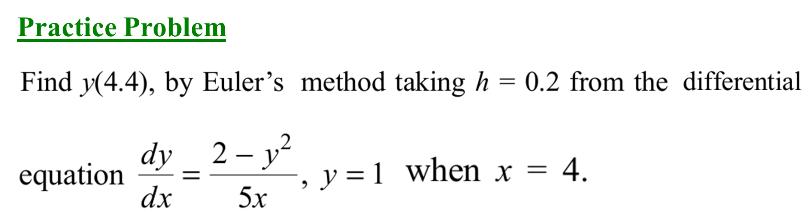
Numerical Methods
National University of Science and Technology, Islamabad

Slide 11
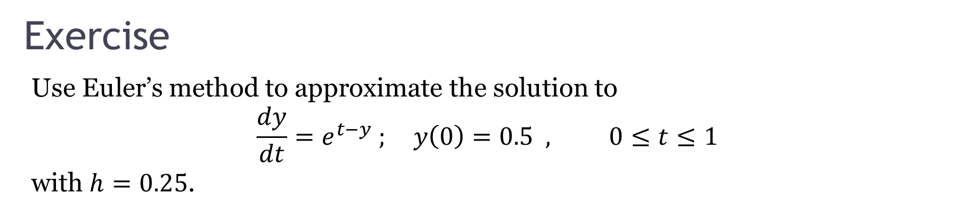
Numerical Methods
National University of Science and Technology, Islamabad

Slide 12
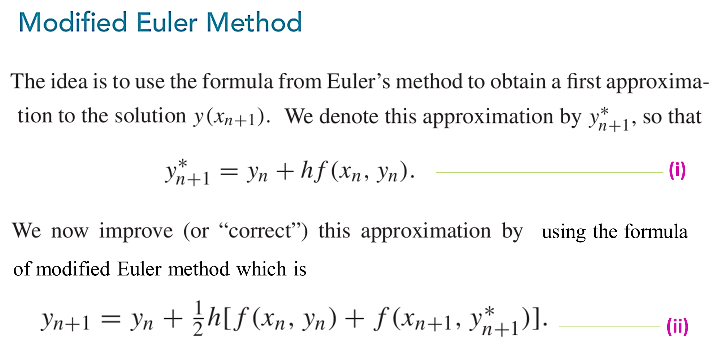
Numerical Methods
National University of Science and Technology, Islamabad

Slide 13
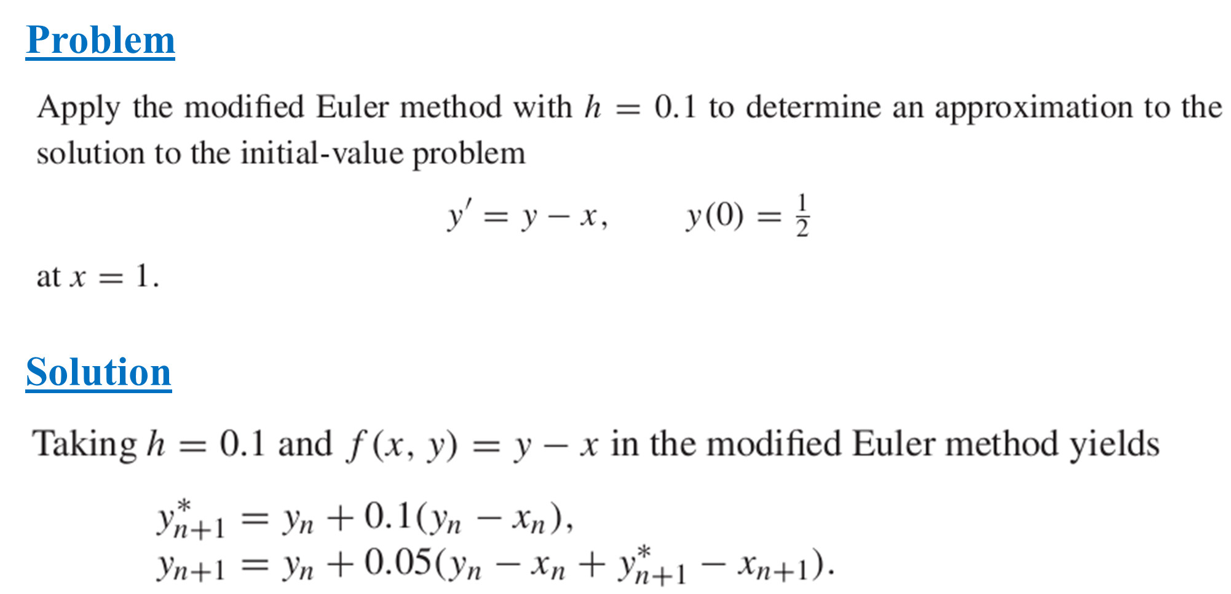
Numerical Methods
National University of Science and Technology, Islamabad

Slide 14
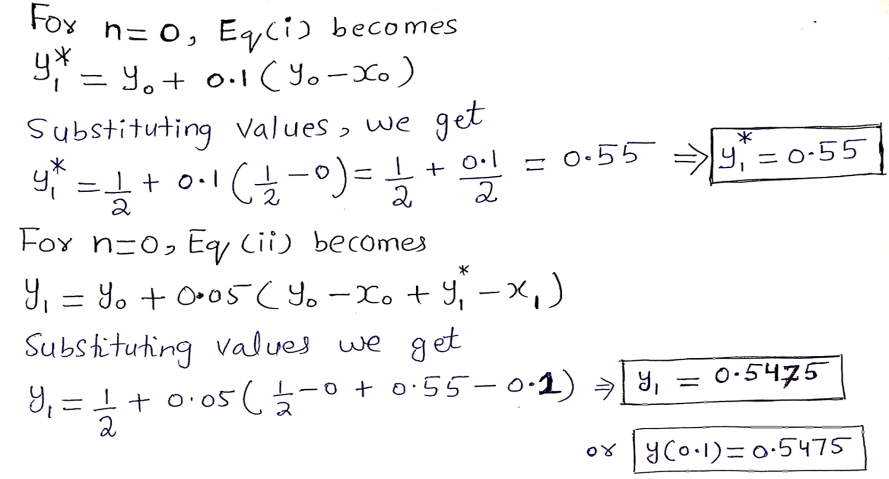
Numerical Methods
National University of Science and Technology, Islamabad

Slide 15
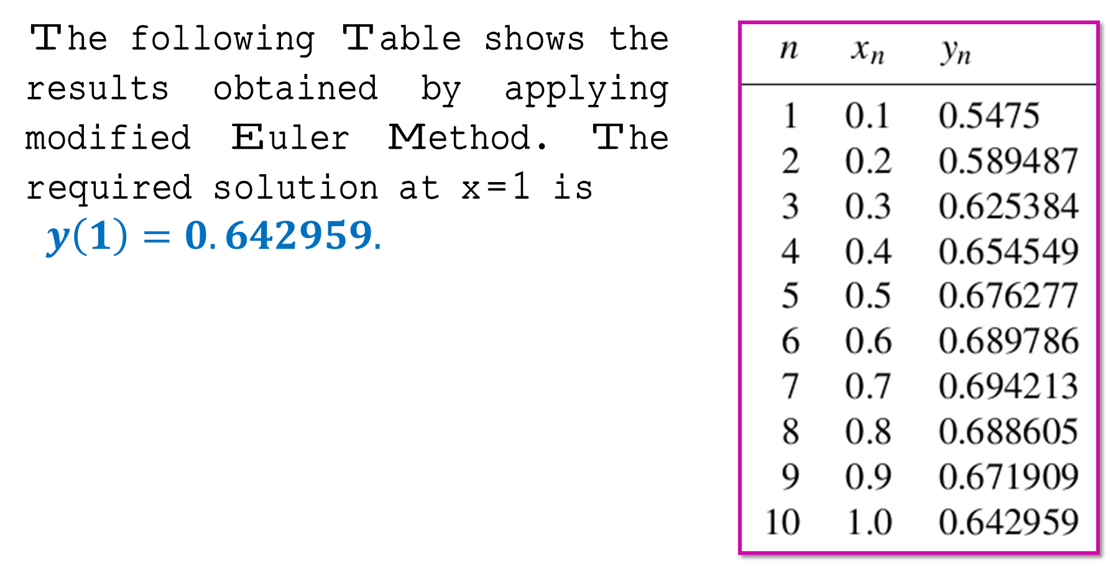
Numerical Methods
National University of Science and Technology, Islamabad

Slide 16
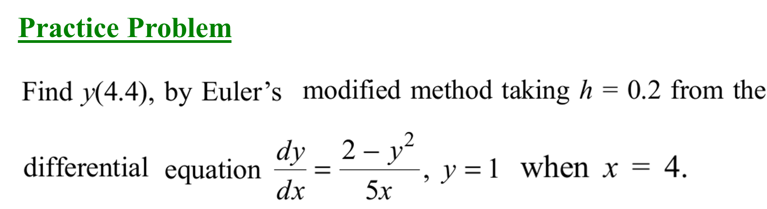
Numerical Methods
National University of Science and Technology, Islamabad

Slide 17
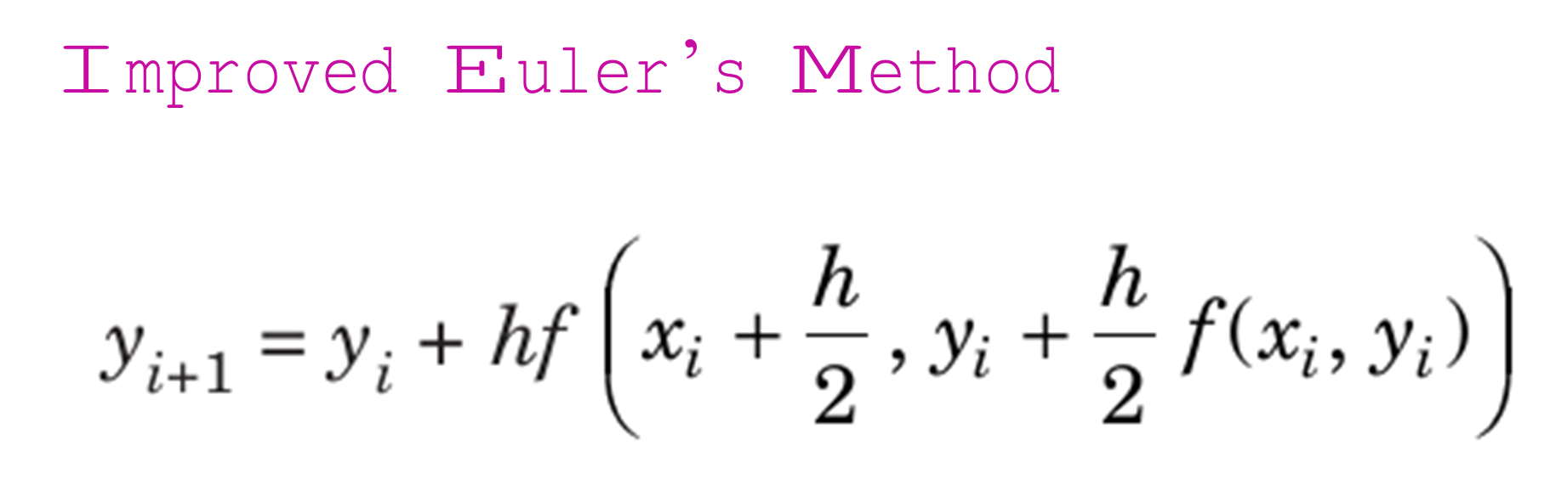
Numerical Methods
National University of Science and Technology, Islamabad

